Slide 2

P2P lending data

Slide 3
Lecturer:
PhD. Đào Thành Chung
Member:
Vũ Đình Phượng (20222150M)

Slide 4
Table of contents
1. Introduction.
2. Architecture.
3. Experiment and result.

Slide 5
1. INTRODUCTION

Slide 6
1. P2P(Peer-to-peer) lending
P2P(Peer-to-peer) lending: Is a financial model that allows individuals or small businesses to borrow money directly from other individuals, bypassing traditional financial intermediaries like banks or credit unions.
Benefits of P2P Lending:
Easier access to loans for individuals and small businesses.
Lenders can diversify their investments.
Potentially Higher Returns.
Simplified Process

Slide 7
P2P(Peer-to-peer) lending
Risks of P2P Lending:
Default Risk: Just like any lending, there's a risk that borrowers might default on their loans, causing potential losses for lenders.

Slide 8
Dataset
Content: P2P lending loans
From LendingClub data report: Is an American peer-to-peer lending company
The Lending Club dataset contains complete loan data for all loans issued through the 2007-2020Q3.
The file is a matrix of about 2925493 observations and 151 variables.

Slide 9
2. ARCHITECTURE

Slide 10
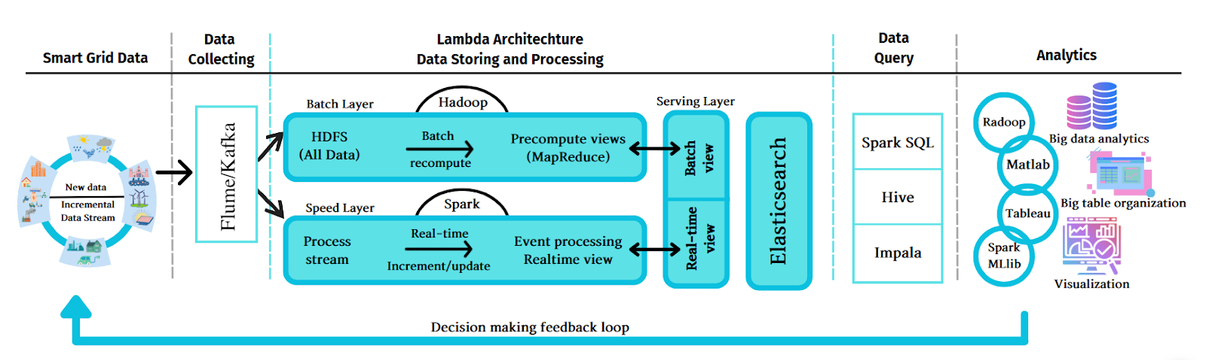
2. Architecture

Slide 11
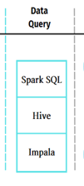

2. Architecture

Slide 12




2. Architecture

Slide 13
Steps
• Begin by employing Google Cloud Storage (GCS) to store the accumulated data.
• Utilize Spark to retrieve data from GCS, carry out processing and comprehensive data analysis. Subsequently, send the resultant indexes to Elasticsearch.
• Allow Elasticsearch to store the indexes provided during the second step.
• Employ Kibana to create a dashboard with visually engaging representations for effective visualization.

Slide 14
Tools
Google Storage: Store the dataset.
Spark:
Use spark to read data from Google Storage.
Data processing: Drop unnecessary columns, fill missing data,…
Analyze the data.
Push index to Elasticsearch.
Elasticsearch: Store index, serve for the Visualization step.
Kibana: Create interactive and visually appealing dashboards, charts, graphs, and maps to analyze and visualize data stored in Elasticsearch.

Slide 15
3. EXPERIMENT AND RESULT

Slide 16
PREPROCESSING DATA
Section Goals:
Remove unnecessary or repetitive features.
We just keep 27 importance features
We only keep the loans with status "Current" or "Fully Paid" or "Charged Off."
If emp_title is omitted, it means Borrowers don't want to offer their work or maybe they are unemployed. So we will fill Other to them.
Remove or fill any missing data.
Drop rows with null values in the "issue_d" column.
Drop rows with null values in the "loan_amnt" column.

Slide 17
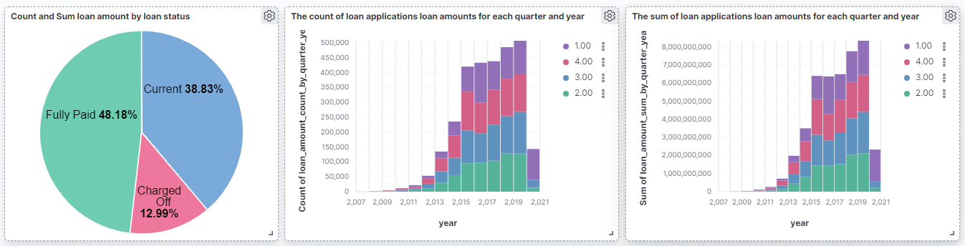
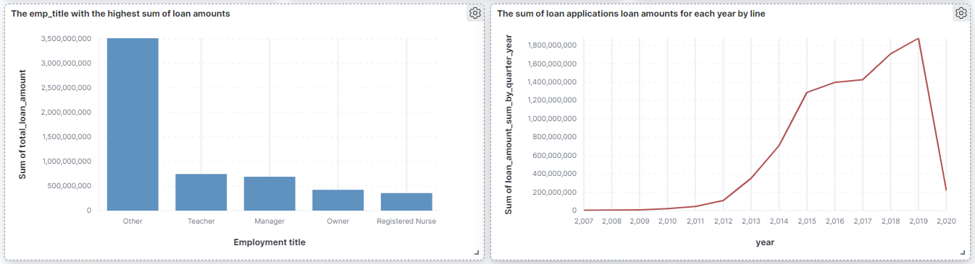
ANALYZE DATA & VISUALIZE
Show more on Demonstration

Slide 18
THANK YOU !

